Slide 1
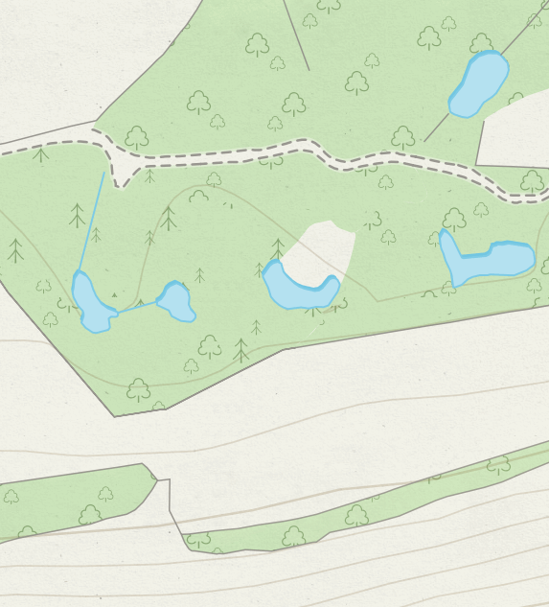
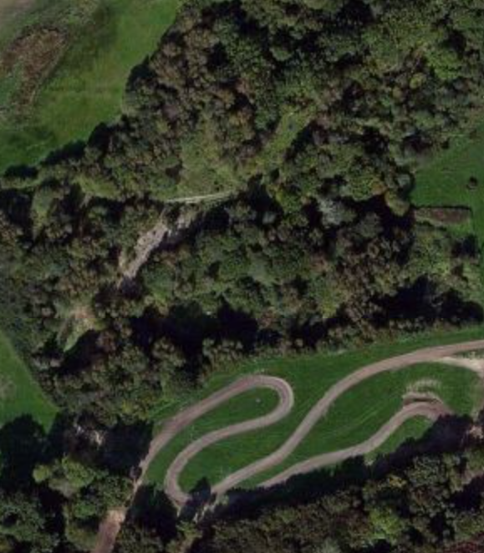
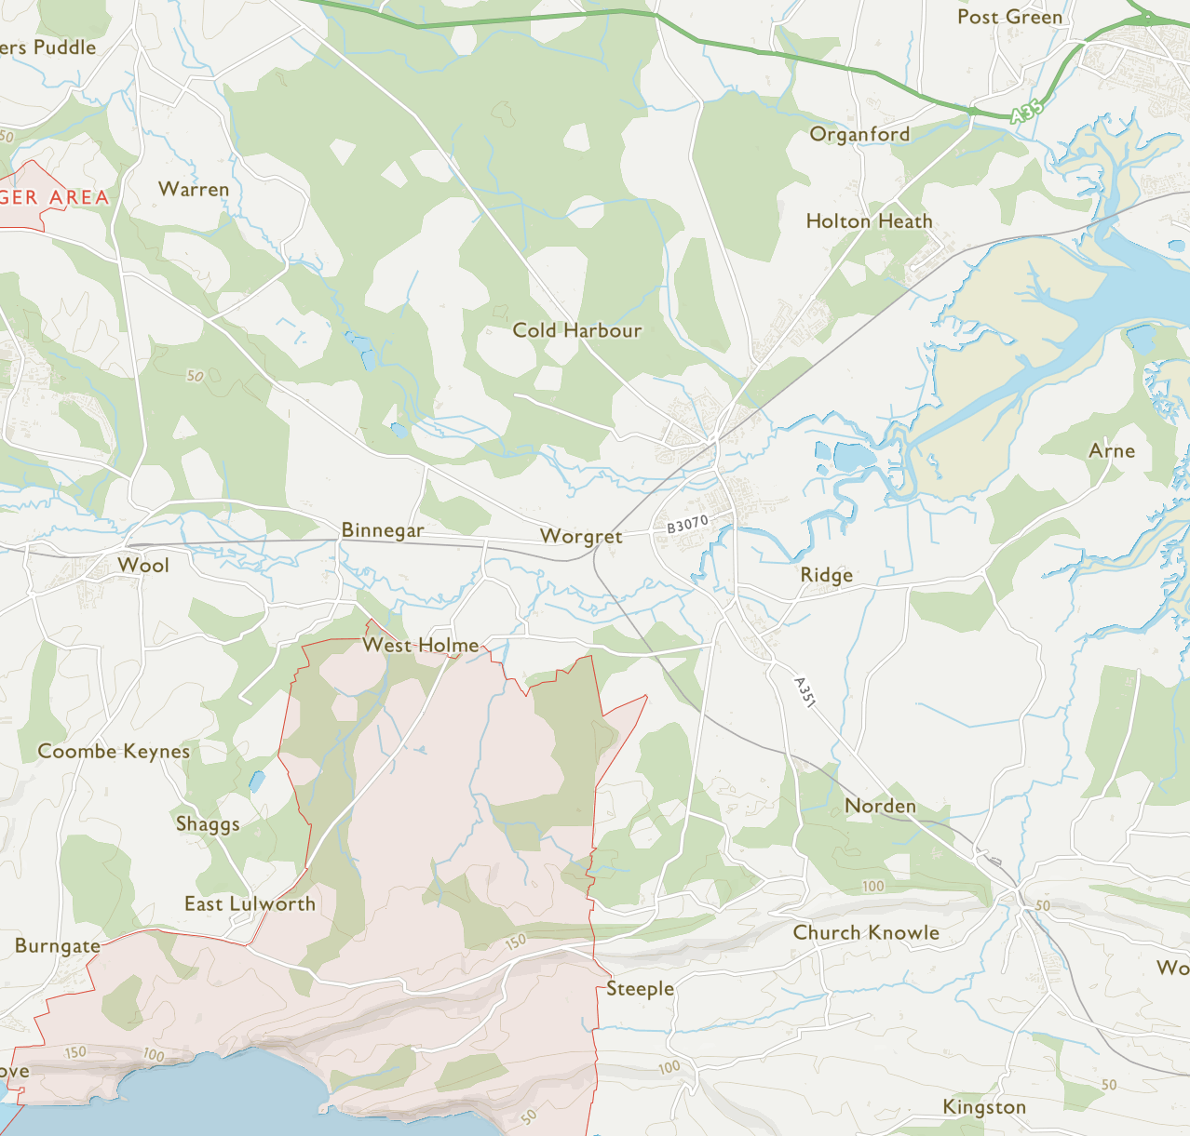
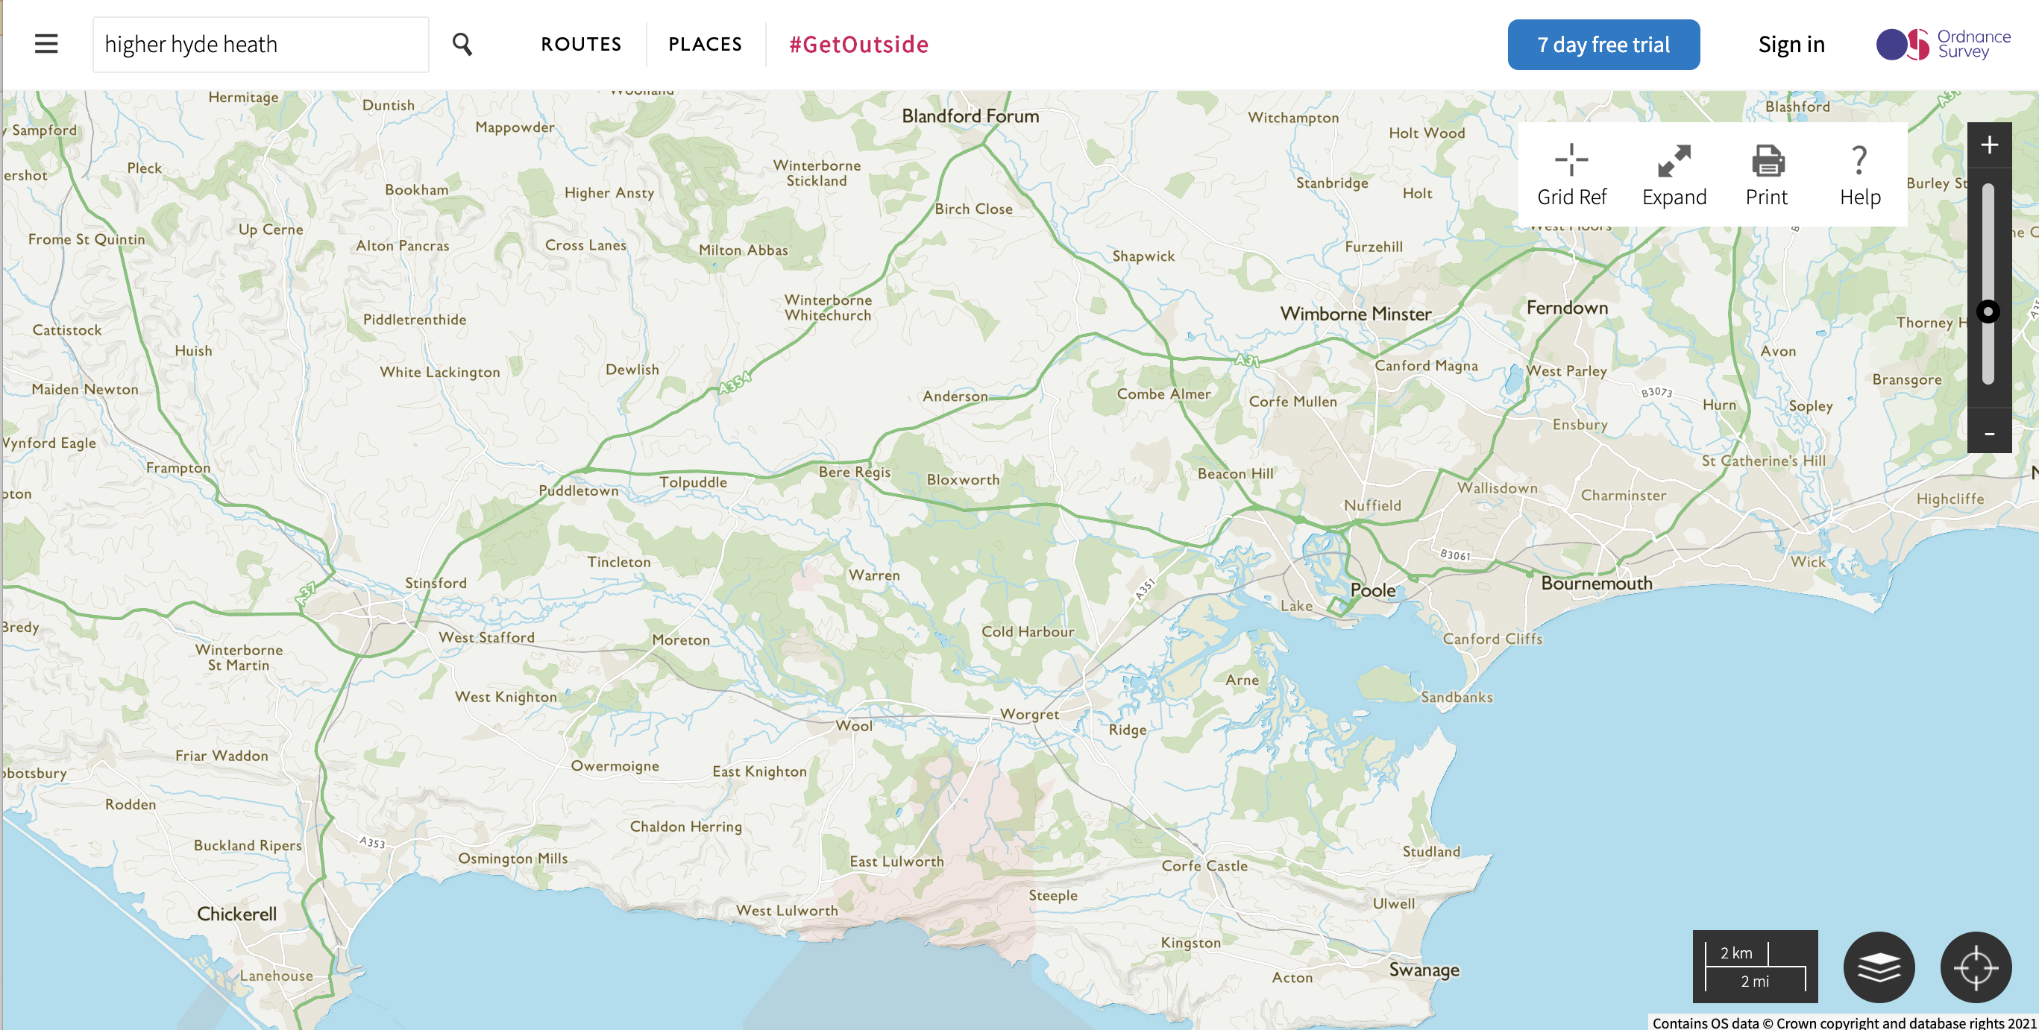
A
B
DOily
C
DMud
W1, W6
DBunk
D8
DCat
Dorset
50 m
A
B
C
D10
W1, W6
Kilwood
DBunk
D8
DCat
Dorset
1 km
50 m
A
B
C
D10
W1, W6
Kilwood
DBunk
D8
DCat
Dorset
4 km
50 m

Slide 2
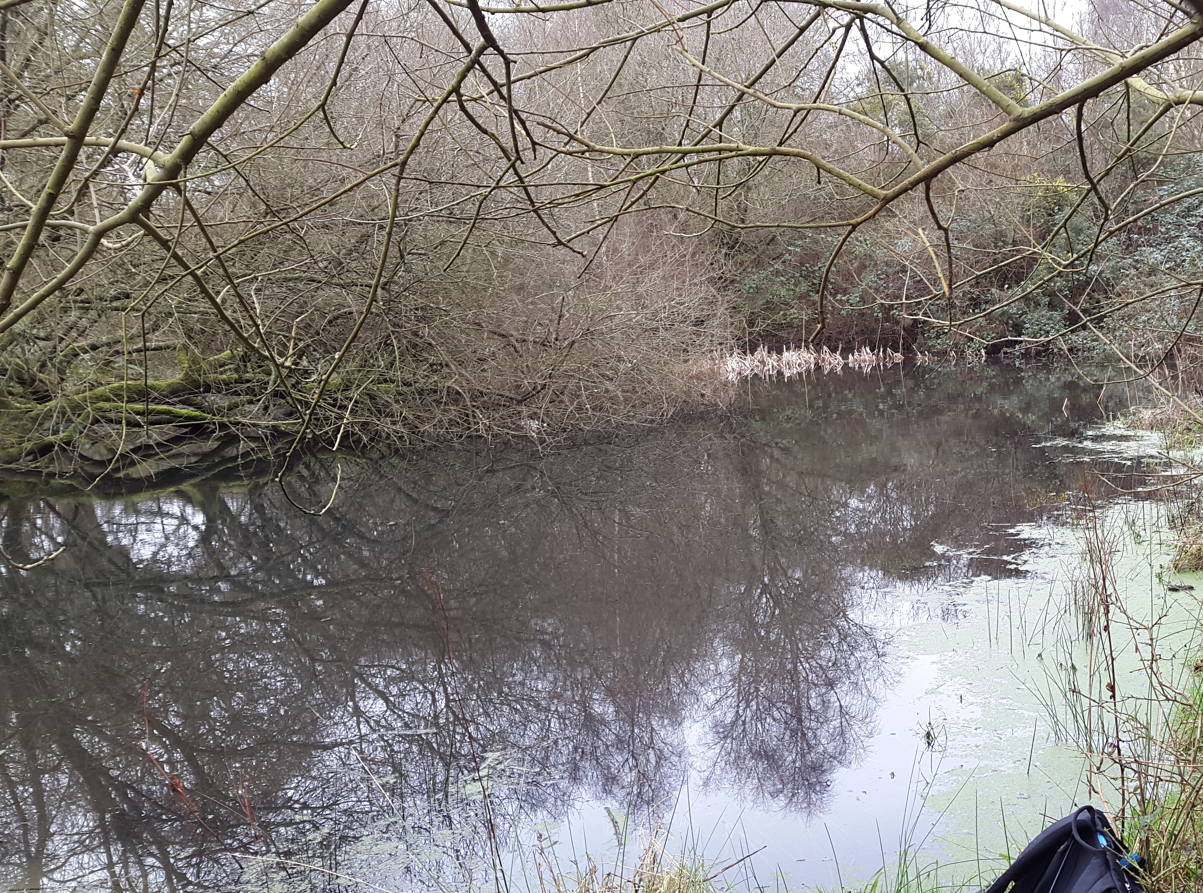
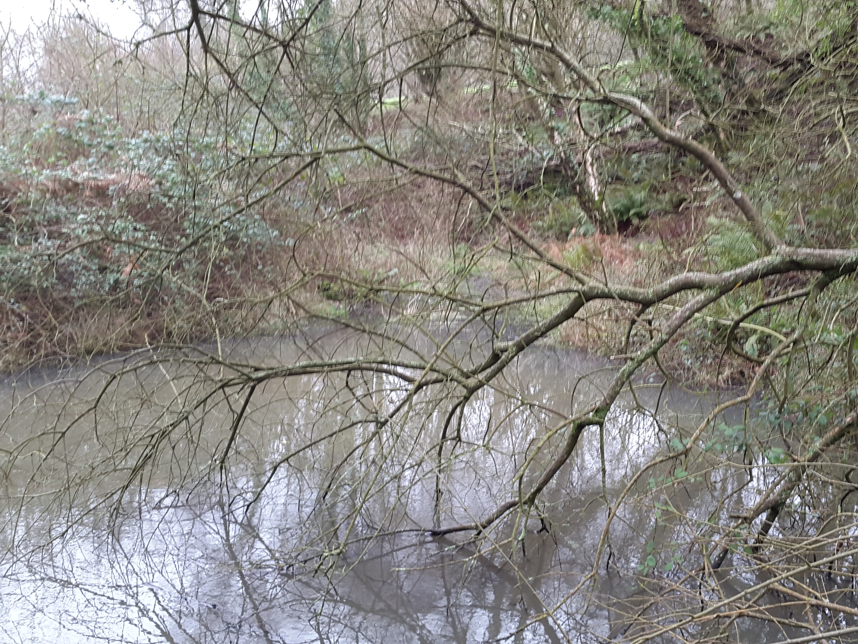
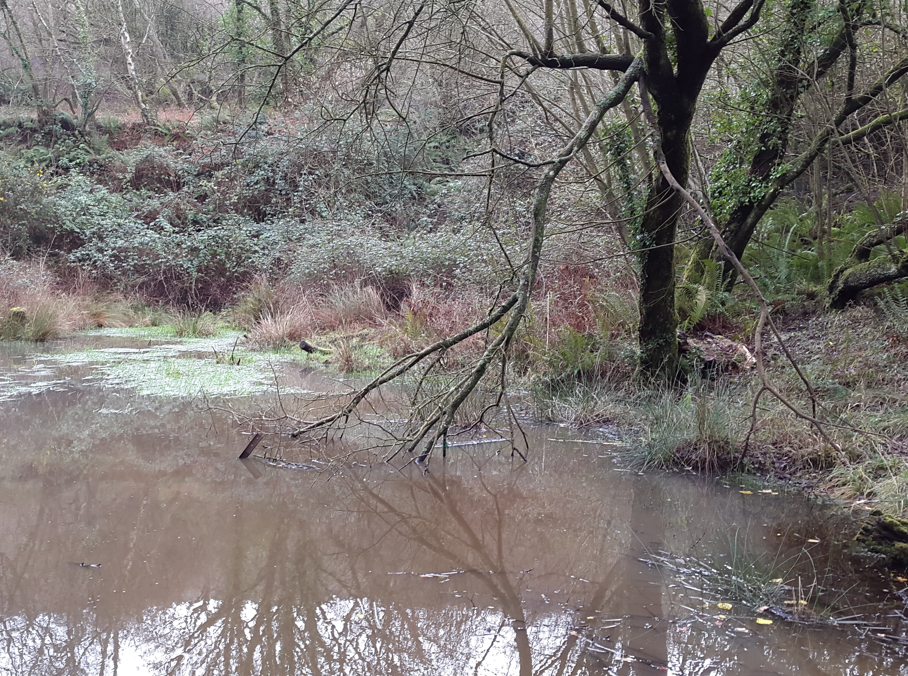
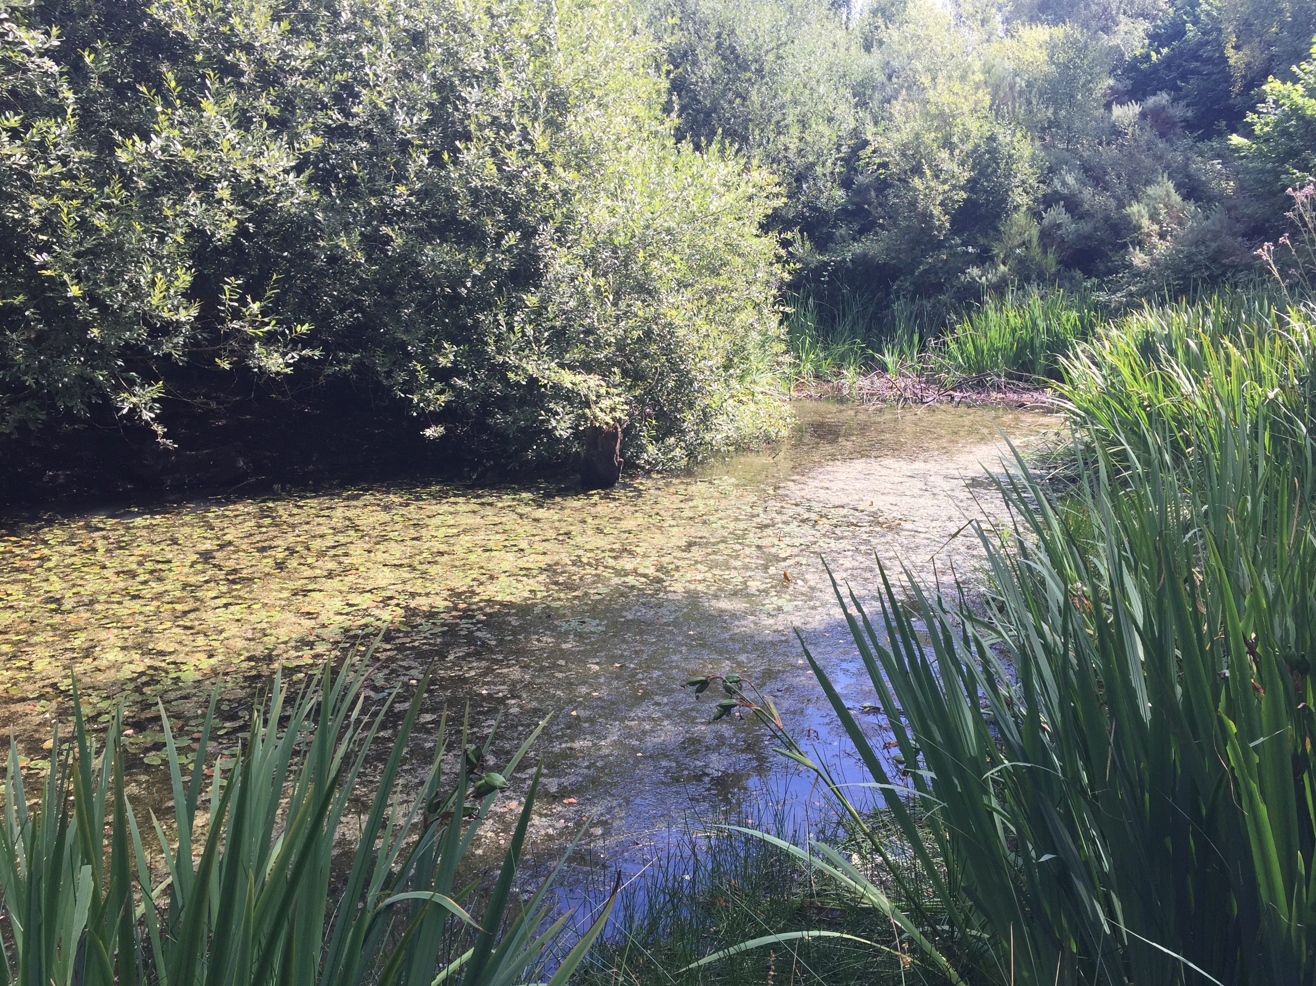
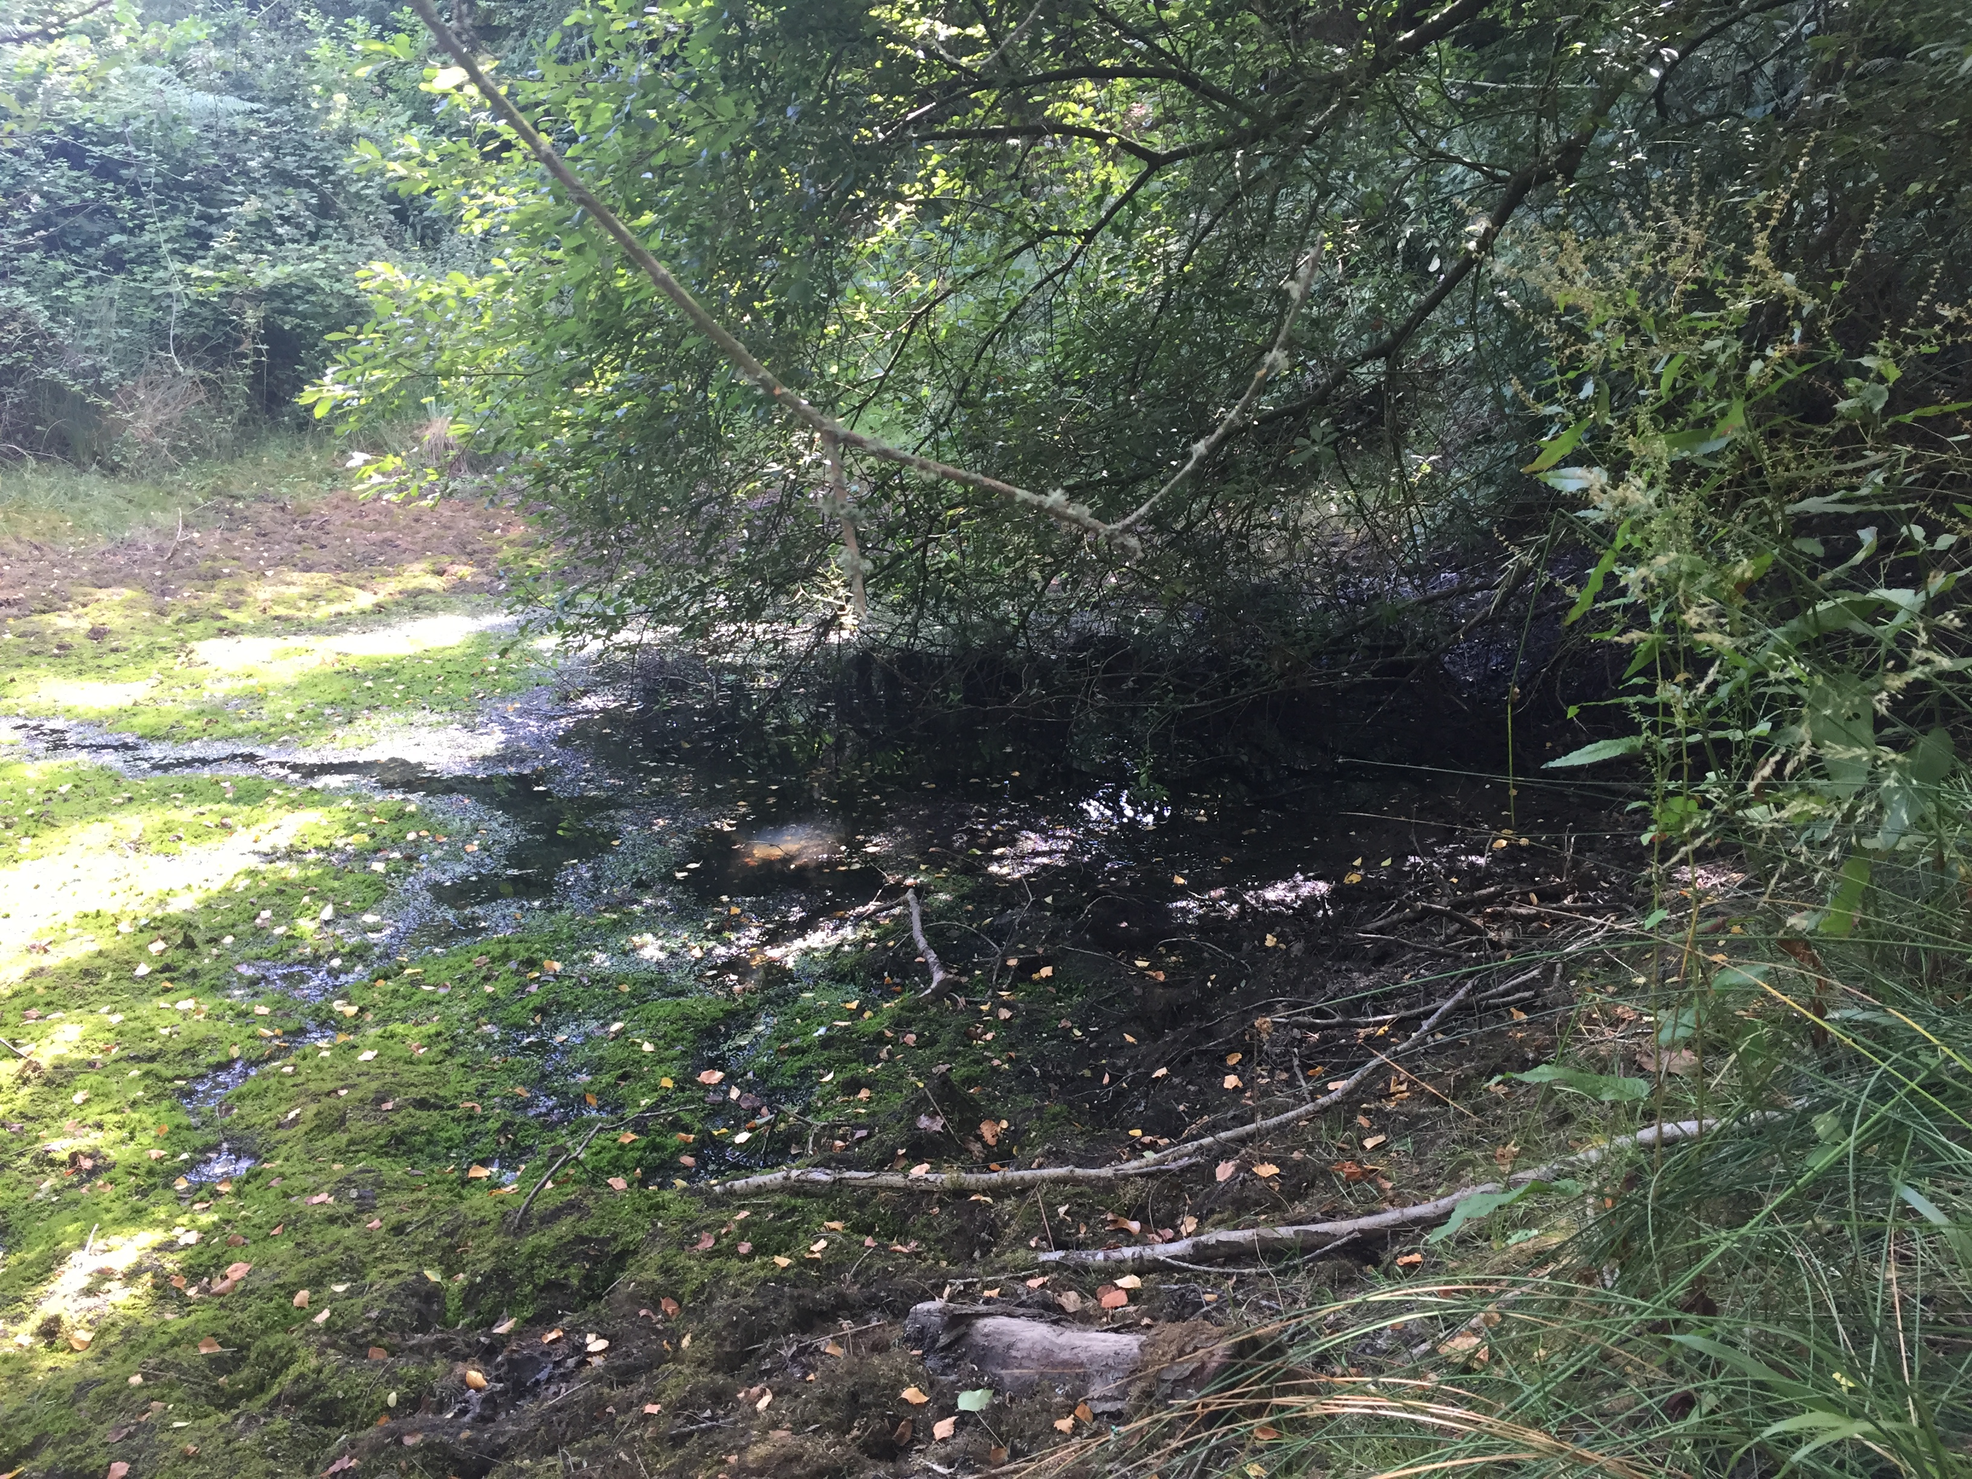
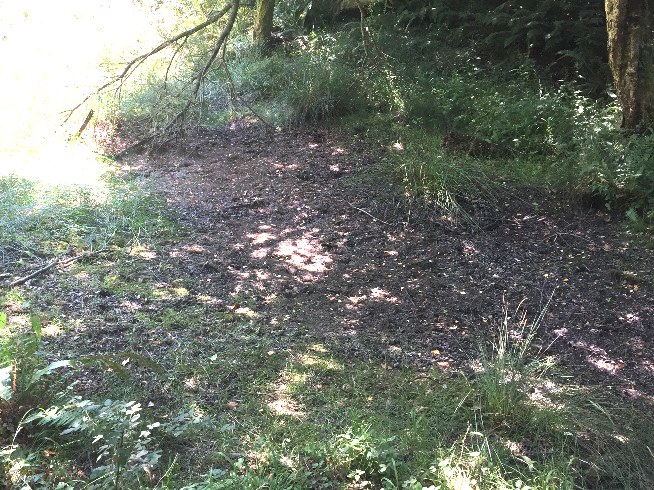

Slide 3
A
B
C
D10
W1, W6
Kilwood
DBunk
D8
DCat
Dorset
1 km
50 m
D
DCat
D8
DBunk
February
July
E
Pond | Water Hardness (ppm) | D. pulex | D. obtusa | Simocephalus
DBunk | 300 | Yes | Yes | Yes
D8 | 340 | Yes | No | Yes
DCat | 215 | Yes | No | Yes
D10 | 250 | Yes | No | Yes
Pond Depth

Slide 4
Notes:
Final Figure 1

Slide 5
50 m

